Slide 1
E-Compliance
Part 4
Version 4
Role CC

Slide 2
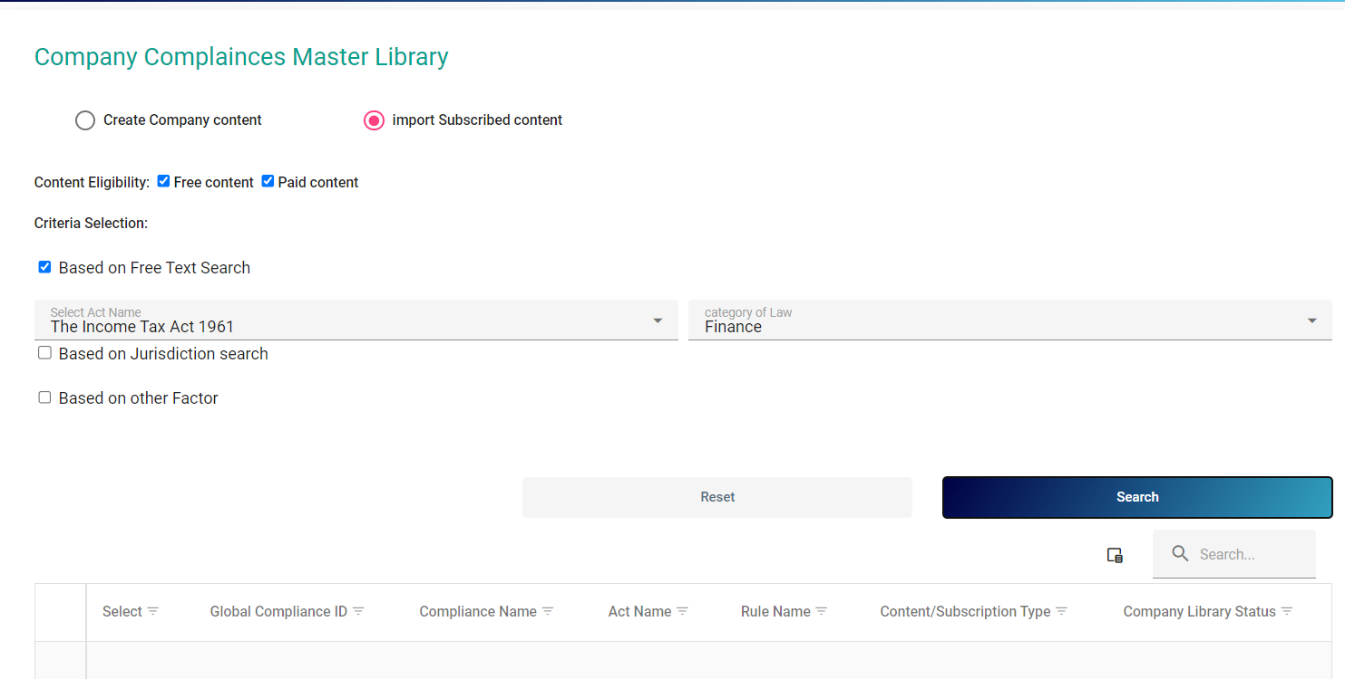
Neither able to import Compliance Data nor any data are being shown here
WORKING ON IT . NOT UPDADATED

